Slide 1
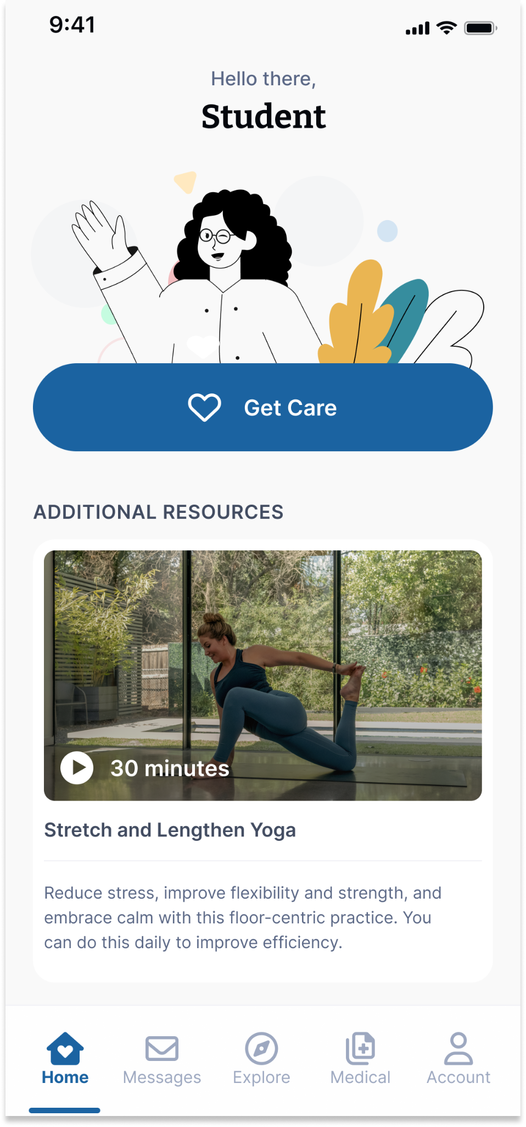
Your Virtual Health and Well-Being Resources
Available on the TimelyCare app or timelycare.com/ggu
MedicalNow
On-demand support for common health issues.
Self-Care Content
Visit the “Explore” page for guided self-care content.
TalkNow
24/7, on-demand emotional support to talk about anything.
Scheduled Medical
Choose your preferred day, time, and medical provider.
Scheduled Counseling
Choose your preferred day, time, and mental health provider.
Scan the QR Code to access care.
@timelycare
QR CODE HERE
It’s for Students.
@timelycare
FOR FREE.
@timely_care

